Slide 1
Week 5 Artist Way Creative Workshop
Rediscovering the Sense of Possibility
Group Artist Date Meeting
Origami

Slide 2
Origami Projects
Supply List:
8 ½ x 11 sheets (4)
Square Origami Paper (multiple misc. colors)
Scissors
Ruler
Double-sided tape
Paper Folder for creases
Instructions

Slide 3
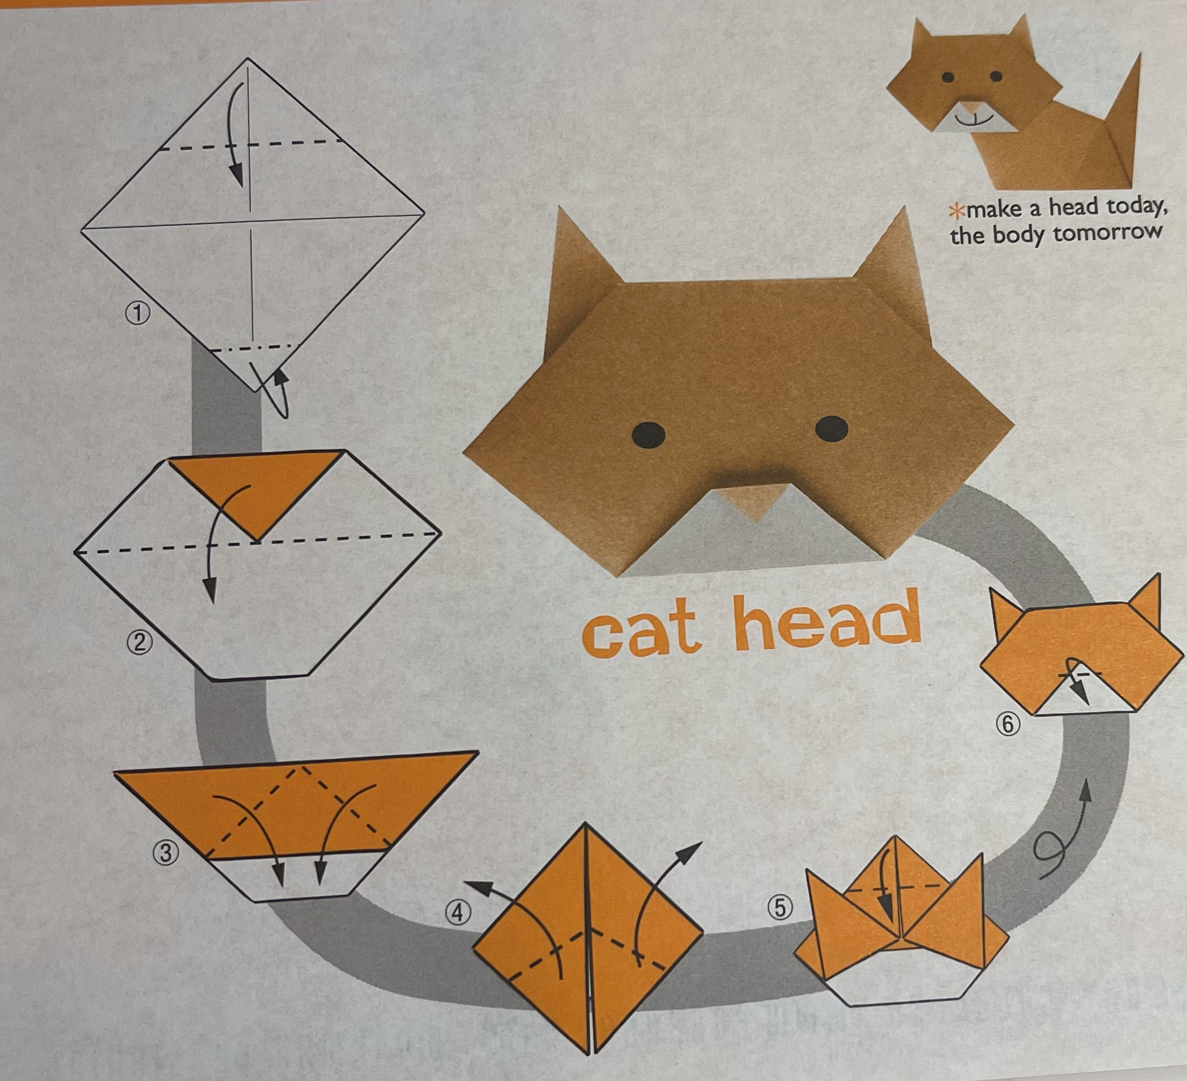
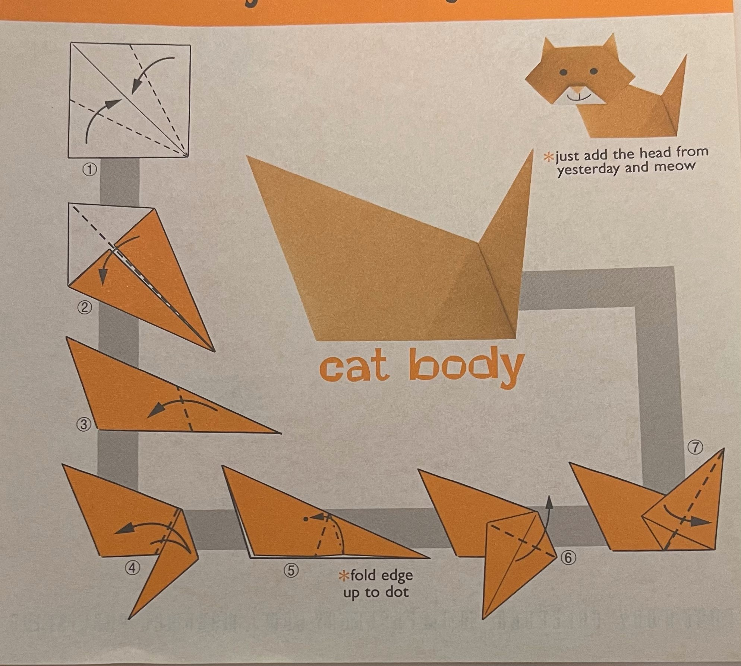
Origami Cat Instructions

Slide 4
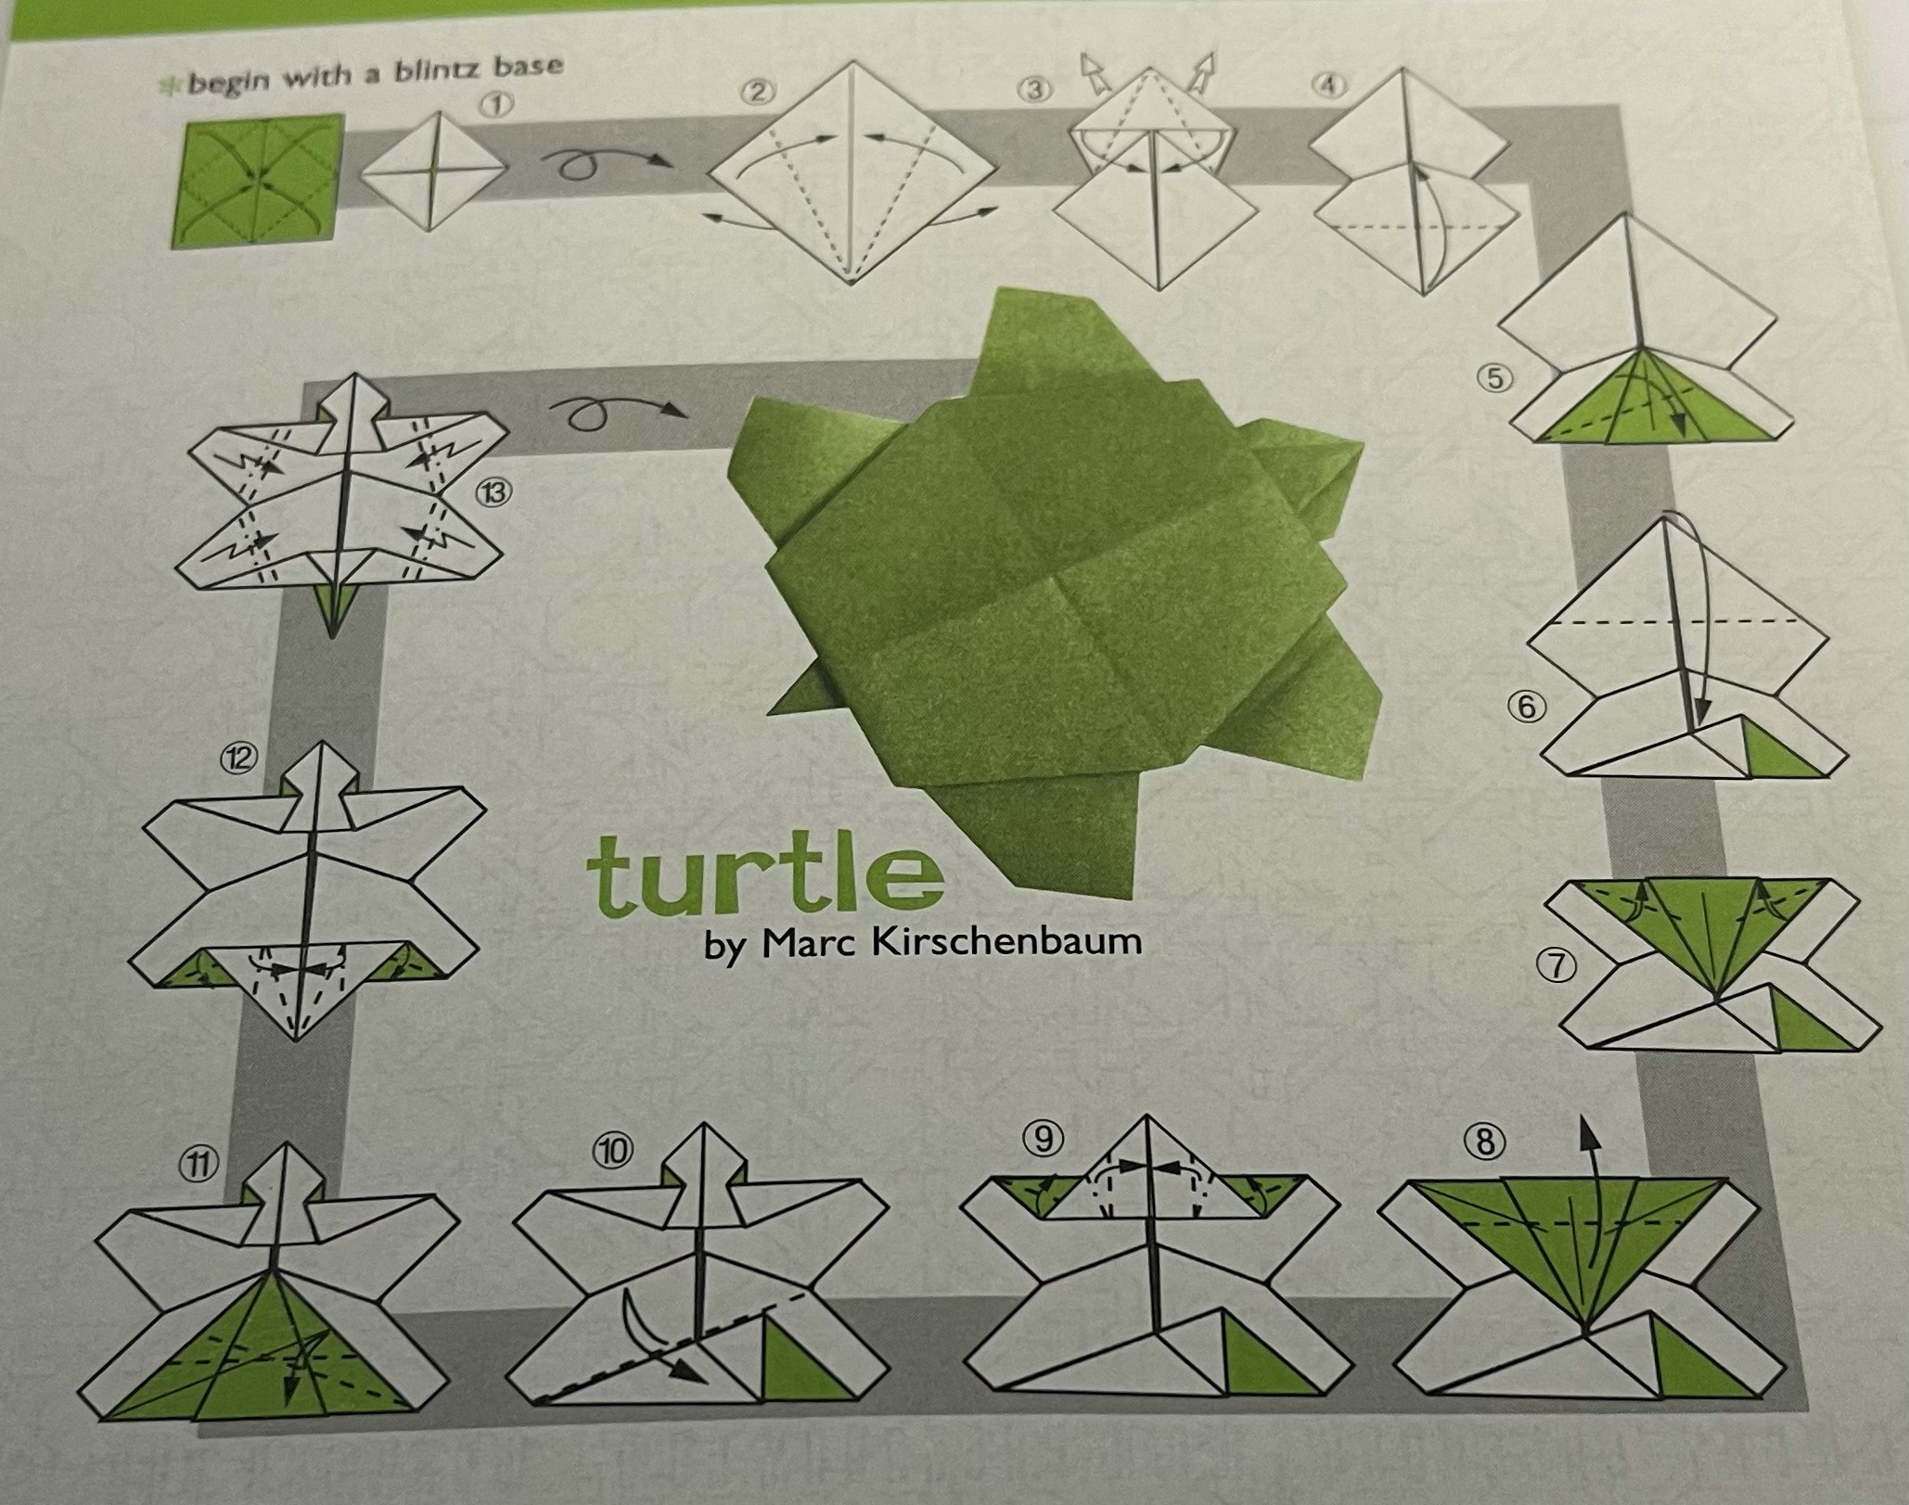
Origami Turtle Instructions

Slide 5
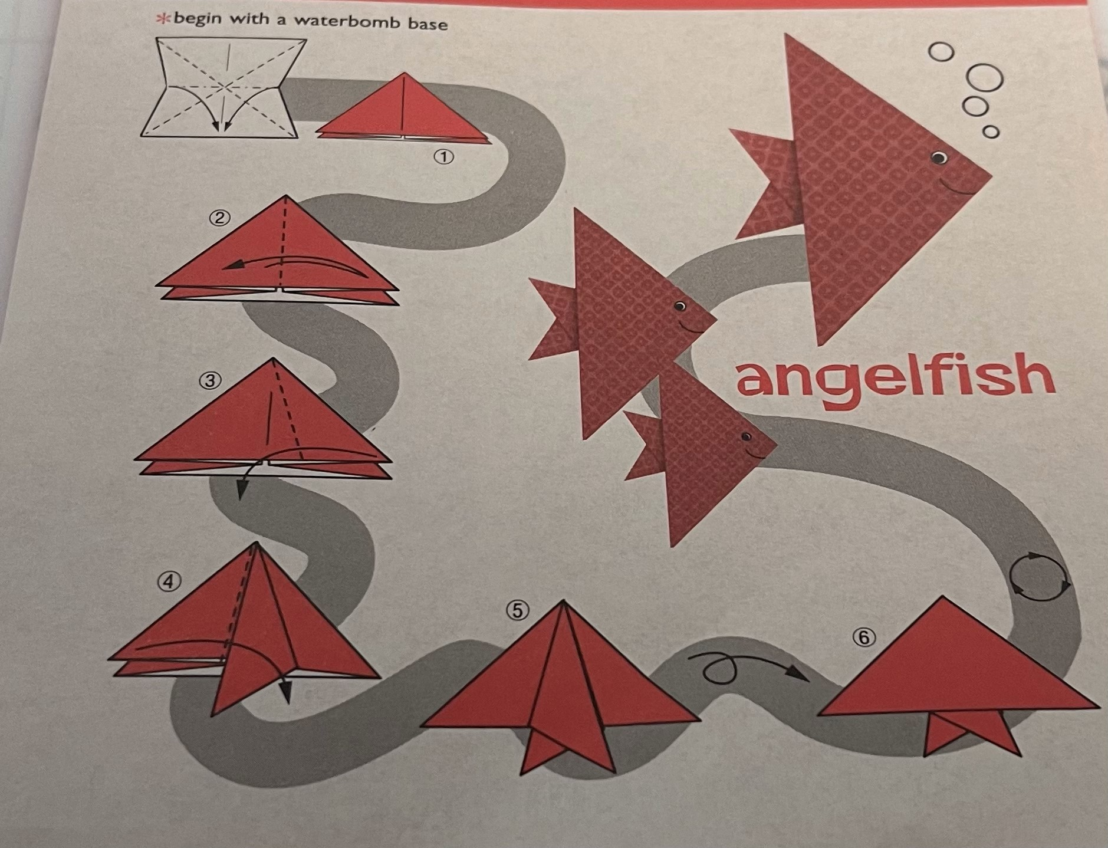
Origami Angelfish Instructions

Slide 6
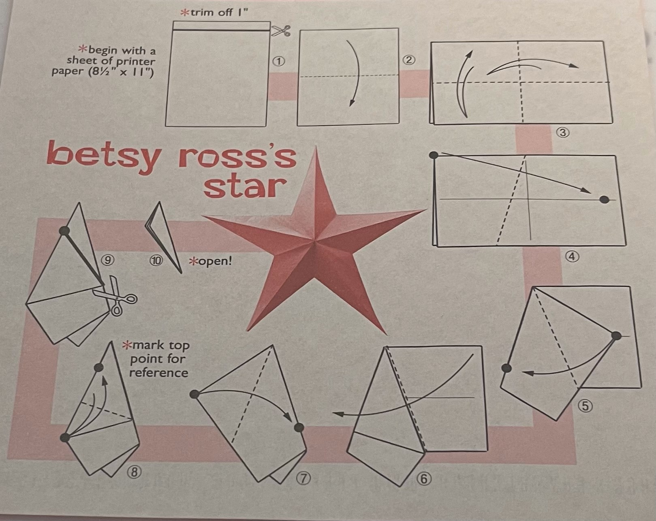
Origami Betsy Ross’s Star Instructions

Slide 7
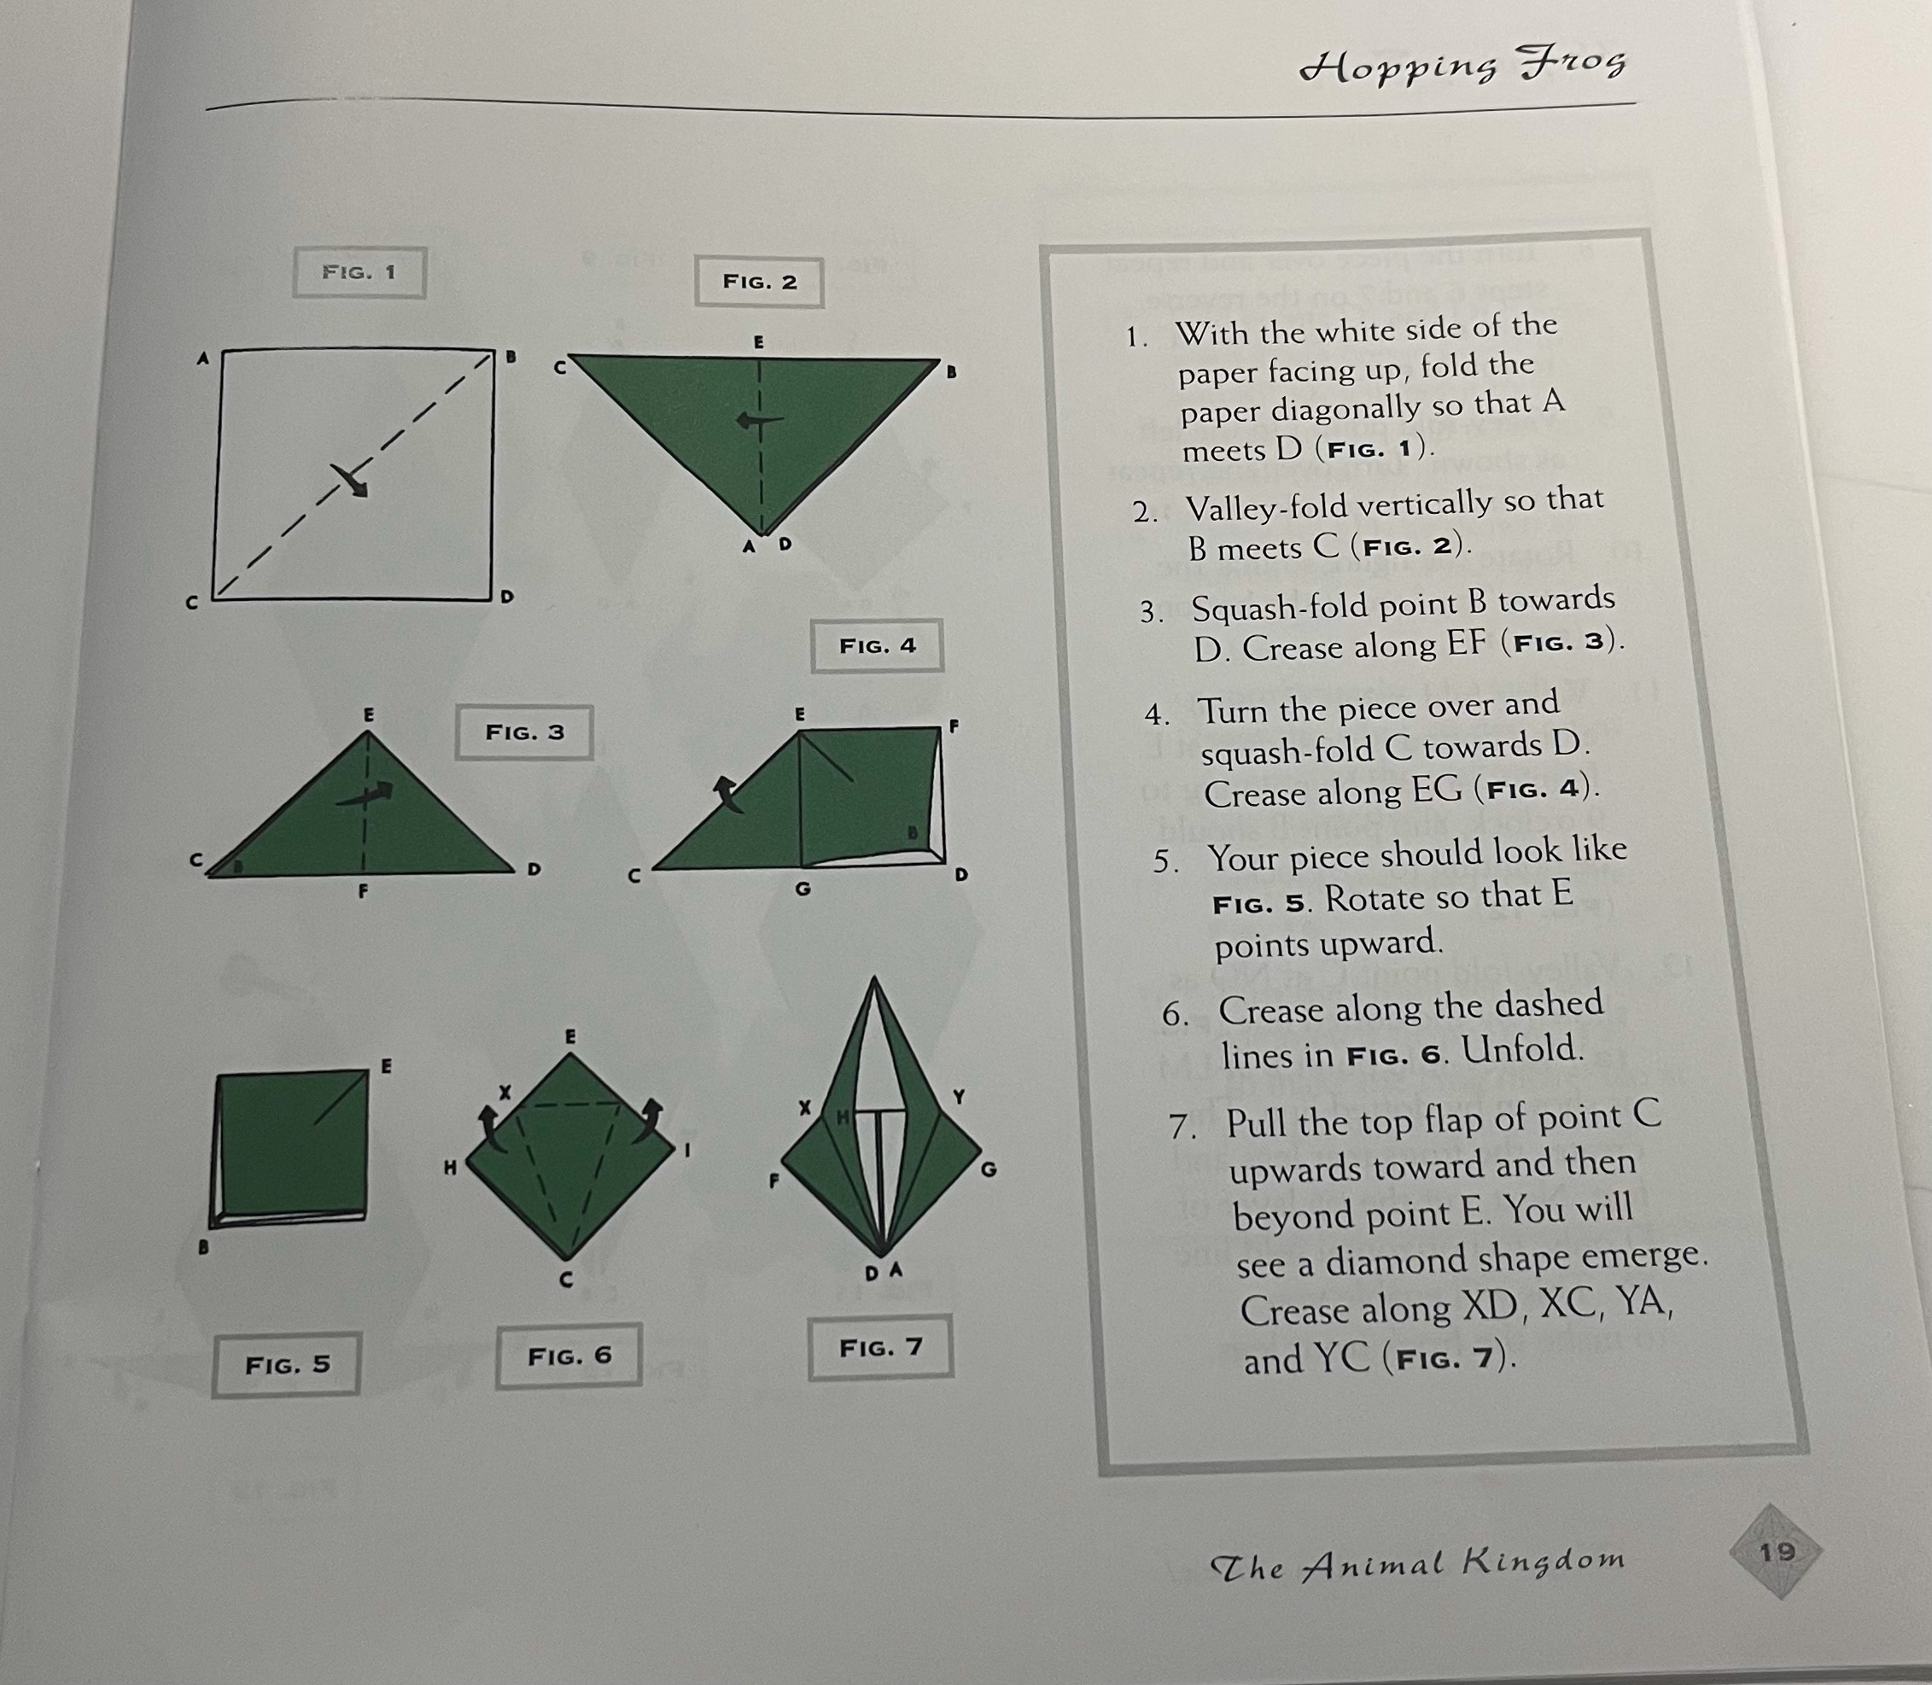
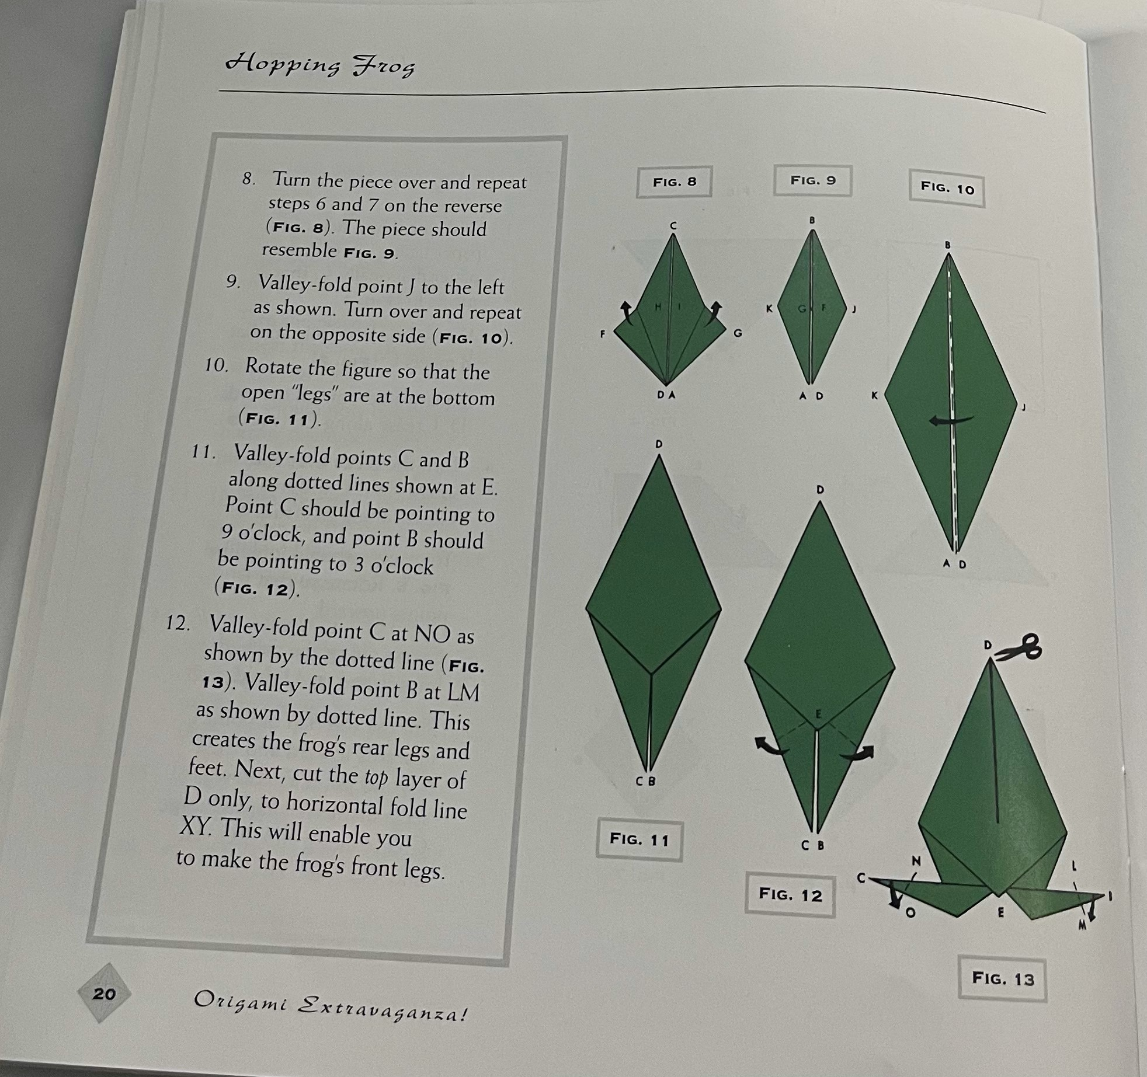
Origami Hopping Frog Instructions

Slide 8
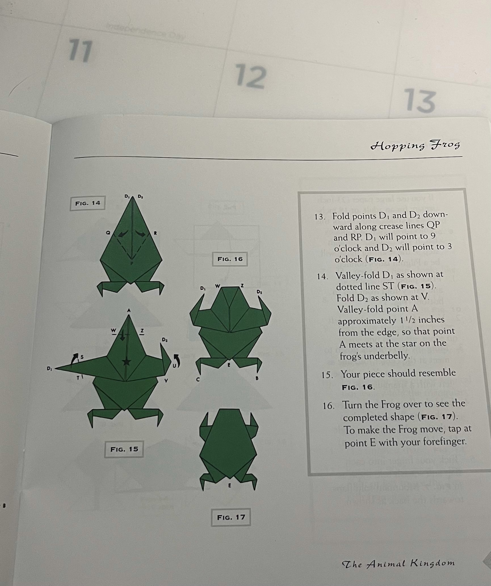
Origami Hopping Frog Continued Instructions

